Slide 1

AUTHENTIC ASSESSMENT IN DUAL MODE UNIVERSITIES IN NIGERIA
Sponsor: COMMONWEALTH OF LEARNING, CANADA
Venue: BabCOCK UNIVERSITY DISTANCE & e-LEARNING CENTRE, Illisan Remo
Date: 30 november - 1 December, 2021
GI Akper & CA Okonkwo

Slide 2
three (3) questions by way of introduction
Which university best meet Nigeria’s higher education needs in the 21st century: traditional (conventional) (FUAA), single mode ODL (NOUN) or a dual mode university (ABU, UI, Babcock etc)?
In addressing Nigeria’s higher education challenges, does the solution lay exclusively with firm commitment to tradition, research and scholarship or the learning needs of learners informed by employers expectations are also important?
How about affordability, access, equal opportunities to university education; also flexibility in our learning delivery (cf. NPE 2004, 2014)?
GI Akper & CA Okonkwo

Slide 3
WORKSHOP OBJECTIVES
Participants appreciate Authentic Assessment as a veritable alternative to Traditional Assessment practices common in the face-to-face delivery mode.
Participants should be able to identify and use Authentic Assessment forms/models relevant to their institutions/learning contexts.
Participants should be able to design authentic assessment forms that best suit learning needs of their learners.
GI Akper & CA Okonkwo

Slide 4
Common features of a DUAL MODE UNIVERSITY IN NIGERIA
Dual mode universities combine face-to-face with distance/e-learning modes of learning delivery.
Distiance Learning in many dual mode universities replaces the abolished sandwich programmes in Nigerian University System (NUS) (cf. Ramon-Yusuf, 2014).
A few out of the many programmes on offer in dual mode universities are offered through distance/e-learning (cf. NUC guidelines for open and distance learning (ODL) mode.
A culture of the university controls assessment processes of the distance/e-learning centres that should be guided by open and distance/e-learning principles.
GI Akper & CA Okonkwo

Slide 5
Univeristy culture? William bergquit’s four (4) cultures of academy
Collegial University Culture
Managerial Univeristy Culture
Developmental University Culture
Negotiating University Culture
W. Berguit (1992) The Four Cultures of the Academy
GI Akper & CA Okonkwo

Slide 6
Collegial university culture
A university with faculties/colleges/schools and departments/units.
The lecturer does authomous (to a large extent) research, teaching and assessments; provided the general university guidelines/norms are observed.
The teacher determines the forms of formative as well as summative asessments for learners.
It hardly accommodate ODL norms on teamwork approach to course design and assessment forms that invite learner inputs.
Academic freedom is emphaized. It is mostly teacher-centric.
By GI Akper & CA Okonkwo

Slide 7
Managerial university culture
It emphasizes economy of scale i.e many students, each paying little
Emphasizes life-long learning – impacting knowledge to learners is more important than scholars researching for own knowledge
Inter-disciplinarity is crucial – no supper discipline, learners can learn anything at any level of their life
Curriculum is designed to solve existing problems (cf. China university system)
GI Akper & CA Okonkwo

Slide 8
Developmental univeristy culture
Promotes ODL values of accessibility, equity, flexibility to accommodate dynamic needs of learners and teachers
Tries to keep to its establishing mission
Insists on developing the learner more than the teacher
Appreciates the values espoused by Managerial University
GI Akper & CA Okonkwo

Slide 9
Negotiating university culture
It emphasis equity i.e. all persons deserve equal treatment and educational oportunities.
Brings different groups together to seek common goals and interests.
While it opposes removal of academic freedom in manegerial and developmental cultures, it nevertheless suggests that for all to receive fair treatment, they should be members of a particular group, or negotiating partners to benefit from outcomes of negotiation.
Interest of a particular group may affect the academic plans of other groups.
GI Akper& CA Okonkwo

Slide 10
Group activity 1
From the four (4) cultures, identity your univeristy’s culture as a dual mode univeristy

Slide 11
does a university culture really matter?
More often than not, ODL practices of a dual mode university are limited by the university’s culture (face-to-face practices determine policies).
ODL assessment practices are acommodated if the university culture accepts ODL ideals of learning.
GI Akper & CA Okonkwo

Slide 12
authentic assessment in dual mode universities?
Authentic Assessment (AA) is a form of assessment of learning outcomes by asking learners to desmostrate competency in skills or knowledge acquired through performing real world task.
It involves giving learners opportunities to SHOWCASE what they know: to explain how they arrived at their conclusions; apply acquired skills to real work scenerio.
GI Akper& CA Okonkwo

Slide 13
Why authentic assessment in dual mode universities? (1)
21st century University is learner-centric.
In ODL, the ”centre of gravity” is shifted away from teacher to learner.
Authentic Assessment is centred on the learner.
DLCs in NUS use economy of scale – more learners requiring limited resources for quality learning. Authentic Assessment paves the way for cost effective assessment administration e.g. large examination halls are not necessary; no invigilators and supervisors required (an AI Proctor is used where need be), no print answer booklets and question papers etc.
GI Akper & CA Okonkwo

Slide 14
Why authentic assessment in dual mode universities? (2)
NUS now insists that learning be copatible with learners’ career interests, lifestyle, and skills. Authentic Asessment measure performance of skills acquired by the learner in a real-work envirolment thereby, meeting learners’ need.
21st century Univeristy is driven by information and communication technology. AA uses technology for its administration.
21st century University is designed to meet learners where they live and work. AA allows learners to be assessed anytime, anywhere.
Cf. Noel Saliu, NUC DAP’s (2014, 262-263).
GI Akper & CA Okonkwo

Slide 15

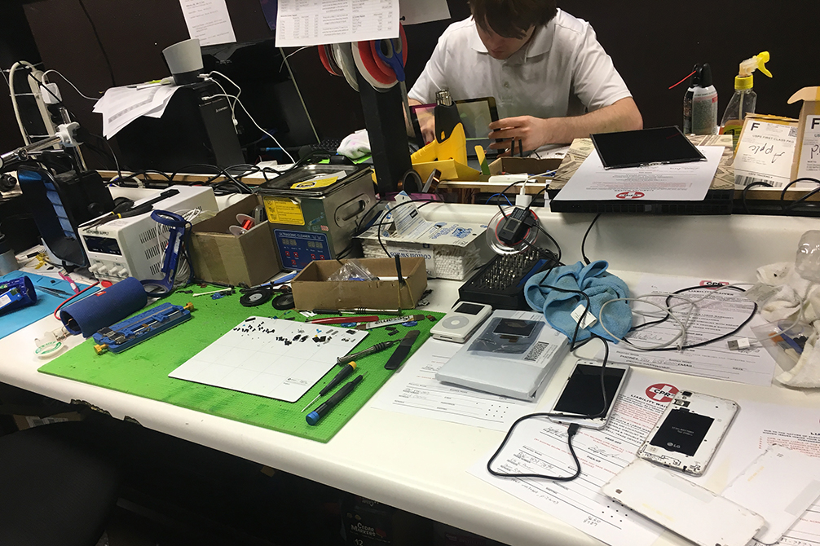
tradiational vs Authentic assessessment pros & cons?
ta
aa

Slide 16
traditional vs Authentic assessessment
Ta
aa
Contrived (does not measure real achievement of learners)
Recall/Recognition (LOTS but not in all cases) (cf. Bloom’s Taxonomy)
Teacher-structured
Curriculum determines assessment
Real world (performing actual task)
Construction/Application (HOTS in all cases) cf. Bloom’s Taxonomy)
Learner-structured
Assessment determines Curiculum
GI Akper & CA Okonkwo

Slide 17
tA and AA pros and cons?
They have the same goal, i.e. train citizens to become productive in society (work place, entreprenuers, mentors, vocation school teachers, artisans and many more)
TA prompt learners to possess a pre-determined body of knowledge. AA insist learners perform real tasks (apply knowledge and/or skills to real tasks, e.g. fix a car as a mechanic instead of describe how a car may be fixed)
TA measure learners’ knowledge/comprehension achievments but AA measure learners proficiency in performing real tasks
GI Akper & CA Okonkwo

Slide 18
Does a university culture affect assessment forms of its dlc?
A Dual Mode university with a Collegial culture will insists that the teacher and curriculum determine assessment forms in DLC and not the other way around.
Authentic Assessment is more likely to be at home in a university with a mixture of Managerial and Developmental cultures than in a Collegial and Negotiating Dual Mode university.
Traditional Assessment patterns in Collegial face-to-face mode is usually transplanted in the DLCs, of many of the 13 operational (14 approved) Dual Mode universities in NUS.
GI Akper & CA Okonkwo

Slide 19
appreciation
Thank you
GI Akper & CA Okonkwo

