Slide 1

Validating Authentic Assessment Items
What is validation?
Validation is the process of checking that the assessment tools, methods, judgement, evidence, and processes of the assessment to ensure they meet the requirements of the assessment instrument

Slide 2
The Concept of Validation (I)
Validation is the quality review process of the authentic assessment items.
It involves confirming that the test items are good enough to produce valid, reliable, sufficient, current, and authentic evidence when administered to enable reasonable judgements to be made based on the result of the items administration results.

Slide 3
The Concept of Validation (II)
It includes:
Reviewing items that do not pass the standard and criteria set for the test items
Make recommendations for the future improvements to the test items
Acting upon such recommendations

Slide 4
The Concept of Validation (III)
Validity of Authentic Assessment Items means appropriateness of the authentic assessment items
Ensuring that AA items are valid for the desired outcome
It is a qualitative review process to confirm that the questions relating to the construction of authentic assessment tasks are effectively and appropriately taken care of in the assessment task

Slide 5
Types of Validity
Different types of validity are examined before an AA item is accepted as valid
Validity tells us how accurately an item measures what it claims to measure
If an item measures what it claims to measure, and the results closely corresponds to real-world values, then it can be considered valid
Validation may refer to:
the items interpretations of scores derived from the assessment; and/or
the application of the test results to educational decisions

Slide 6
Construct validity (I)
Refers to whether the method of assessment will actually elicit the desired response from the examinees
Does the item measure the concepts that it intended to measure?
Construct validity evaluates whether an item really represents the interest we are interested in measuring with that item or items
A construct refers to a concept or characteristics that cannot be directly observed but can be measured by observing other indicators that are assessed with it

Slide 7
Construct validity ii
Construct can be characteristic of individuals such as intelligence, obesity, job satisfaction or depression among others
They can also be broader concepts applied to organizations or social groups such as gender equality, corporate social responsibilities, or freedom of speech

Slide 8
Construct validity iiI
Some of these concepts can only be measured by indicators
Hence, construct validity is about ensuring that the items of measurement match the construct we intend to measure

Slide 9
Content validity (I)
Content validity assesses whether authentic assessment items are representative of all aspects of the construct
To produce valid results, the content of the authentic assessment items must cover all relevant parts of the subject it aims to measure
If some aspects are missing from the measurement (or irrelevant aspects are included), the validity is threatened

Slide 10
Content validity (II)
Content validity is usually determined by the experts in the content area to be assessed. Content validity requires the use of recognized subject matter experts to evaluate whether the items designed for the assessment are relevant for defined content
Content validity requires more rigorous statistical test than does the assessment of face validity

Slide 11
Content validity (III)
Content validity in academic and vocational areas authentic assessment items need to reflect the knowledge actually required for a given topic area or job skills
Succinctly put, an item has content validity if it measures knowledge of the content domain of which it was designed to measure its knowledge
That is, content validity concerns primarily the adequacy with which the authentic assessment items adequately and representatively sample the content areas to be measured

Slide 12
Content validity (IV)
What provides evidence of content validity?
Test blueprint and specifications serve as foundation of validity evidence for determining the extent to which the test provides sufficient content coverage

Slide 13
How is content validity established?
In practical terms, content validity is determined by documenting that the structure and content (items) capture the connection between:
the intended measurement concepts and the way learners from the target student population understand and discuss that concept, or
the targeted important work behaviors, activities, worker requirements or outcomes of the learning content in real world.

Slide 14
Face validity (I)
Face validity considers how suitable the content of an item or authentic assessment items seems to be on the surface
Face validity assesses whether the items ‘looks valid’ to stakeholders.
It is similar to content validity, but face validity is a more informal and subjective assessment

Slide 15
Face validity (II)
It is a subjective measure and its often considered the weakest form of validity
However, it can be useful in the initial stages of developing the items where it could be employed to determine whether the authentic assessment items appear to measure what it is supposed to measure

Slide 16
Criterion validity
Criterion validity evaluates how well authentic assessment items can predict a concrete outcome, or how well the results of the authentic assessment items (would) approximate the results of another set of authentic assessment items already validated.
A criterion variable is an established measurement that is widely considered valid, sometimes inferred to “gold standard” measurement.
Criterion variables can be very difficult to find.
Criterion validity of an instrument is judged based on the criteria set for the assessment.

Slide 17
How is Criterion validity established?
To evaluate authentic assessment items for criterion validity, the result of the administered authentic items is correlated with the result of earlier established authentic assessment criterion measurement.
A high correlation gives a good indication that the authentic assessment item is measuring what it intends to measure

Slide 18
How is Criterion validity established?
To establish the criterion validity of the new authentic assessment items, both the new items and the earlier ones (known valid measure of the criterion) are administered to the same cohort of learners.
The results of both sets of items administered on the same group of learners are correlated and compared.
If the outcomes are very similar, the new set of authentic assessment items are said to have high criterion validity

Slide 19
Concurrent validity & predictive validity
Concurrent validity – Concurrent validity refers to how the authentic assessment items compare with similar instruments that measure the same criterion.
Predictive validity – Predictive validity is concerned with how well an individual’s performance on an authentic assessment item measures how successful he will be on the same future measure.

Slide 20
Validation - the quality review process (I)
Checking whether the items are in conformity with:
the learning outcomes, the standard, the criteria, the professional, and accreditation body requirements, … earlier set out to achieve with the authentic assessment items constructed
to be able to produce valid, reliable, sufficient, current, and authentic evidence to enable reasonable judgments to be made as to whether the requirements of the authentic assessment items are met.

Slide 21
Validation - the quality review process (II)
For the authentic assessment items to be valid, the items require:
To cover the broad range of skills and knowledge that are essential for competent performance of the unit or theme performance.

Slide 22
Validation - the quality review process (III)
The knowledge and skills required by the unit or theme are integrated with their practical application.
The authentic assessment items are to be based on evidence that demonstrate that the learner could demonstrate these skills and knowledge in other similar situations.

Slide 23
Validation - the quality review process iiI
The judgment of competency is based on evidence supplied by the learner against the unit or theme requirements.
For the authentic assessment items to be valid,
the assessor is to assure that the items are such that the learner has the skill, knowledge and attributes as described in the unit or theme competencies requirements.

Slide 24
Hands – on 2 To validate the constructed authentic assessment items
To validate the authentic assessment items constructed we have to consider the infographic (Mueller, 2018) that guided the authentic assessment item construction process and provide answers to the questions posed.
That is, we should provide answers to the questions with respect to the specific authentic assessment items constructed in this sensitization workshop.

Slide 25
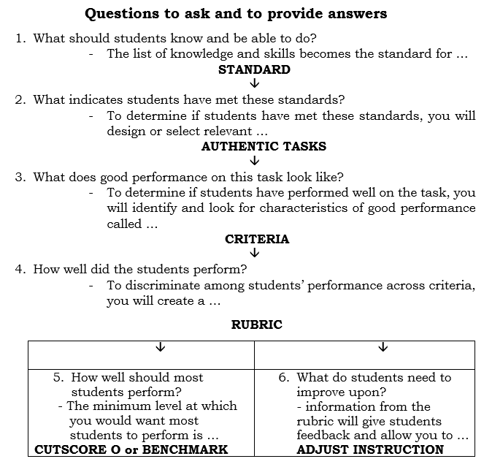
Hands – on 2 To validate the constructed authentic assessment items i

Slide 26
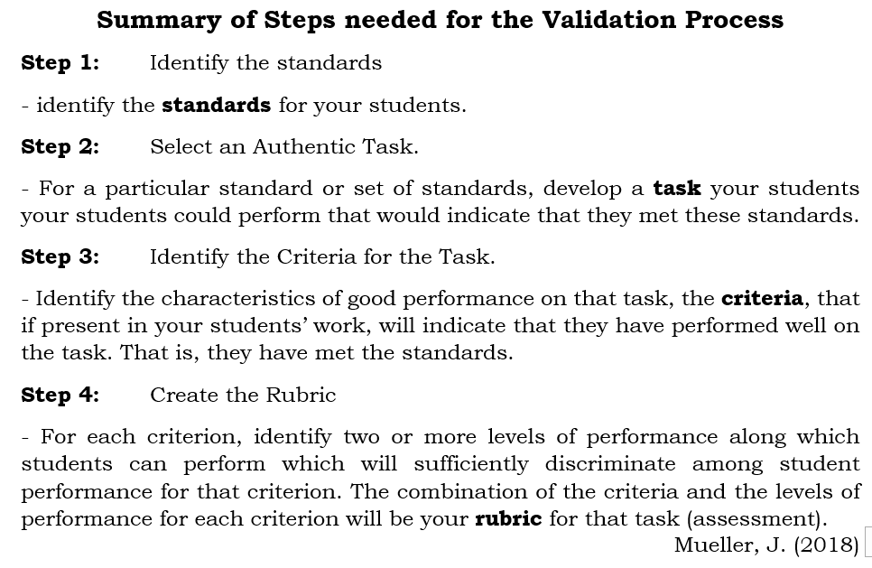
To validate the constructed authentic assessment items ii

Slide 27
Rubric for validating the constructed authentic assessment items
Group:
Subject area:
Item No.:
Criteria | Weight | 4points | 3points | 2points | 1point | Comment
Step 1: Identify the Standards
Step 2: Select an Authentic Task
Step 3: Identify the Criteria for the Task
Step 4: Create the Rubric
The Authentic Assessment Item 1

Slide 28
recap
Repeat the same process for the items you have constructed and present to the participants for critique – Self and Peer Assessment and Validation.
Identify areas that need improvement and suggest ways of improving such areas.
Submit softcopy to the facilitators for their input.

Slide 29
appreciation
We Thank you immensely for your very active participation

